Slide 1
GAME’S RATING and what’s effect them.
Data science project with Machine Learning
Shahar Eliyahu
Arad Bivas
GitHub

Slide 2
Our Research Question: CAN WE PREDICT THE GAME'S RATING?
What features effect the game’s rating?
Does the game rating depend on which platform can you play it on?
Does the genre of the game effects it’s rating?

Slide 3

Data Source of information:
In this project we use RAWG database website to get the information of the games
We used BeautitfulSoup to crawl the data
The RAWG website uses infinity scroll, we had to use Selenium in order to scroll the site.
The data we got contains 13500x9 cells of data.

Slide 4
Data Cleaning
Drop duplicates: we dropped about 160 rows of duplicated data, caused by that same game can have different genres, and therefore appear multiply times.
Dropped null’s values.
Cleaned the numeric columns from unnecessary string and changed type to numeric values.
Checked for outlier, and decided which values are in range and which aren’t.
Changed columns to one hot to get better results

Slide 5
DATA CLEANING: Droping nulls
01
We saw that this columns had large numbers of null values which we couldn’t fill, so we dropped them.
Devolopers
02
Publisher
03
Age Rating

Slide 6
Data Cleaning: Average Play Time
Numerics Values
Outliers
Null Values
Checked for outliers,
droped values above 200 hours of play time.
Filled the null values with the median
stripped the data from unnesscery string and changed values to numerics.

Slide 7
EDA AND VISUAILIZATION

Slide 8
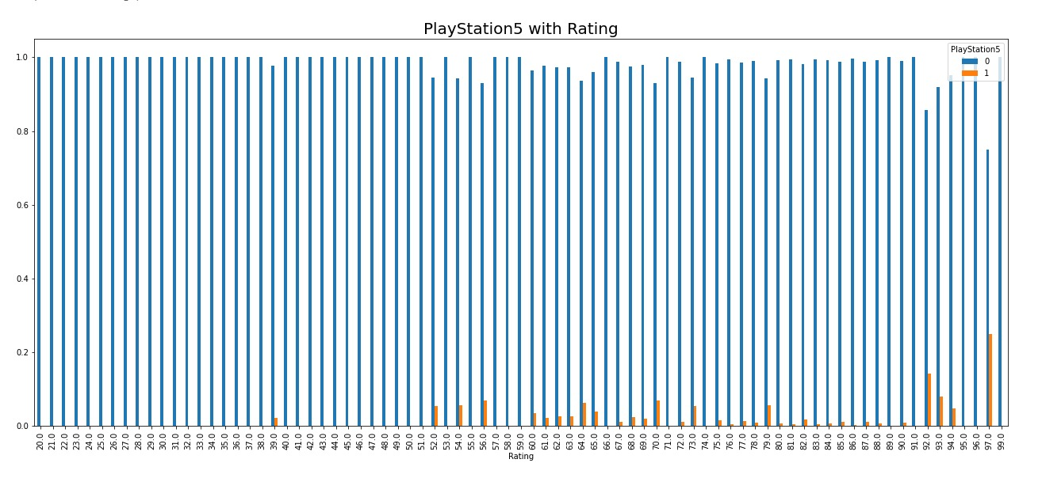
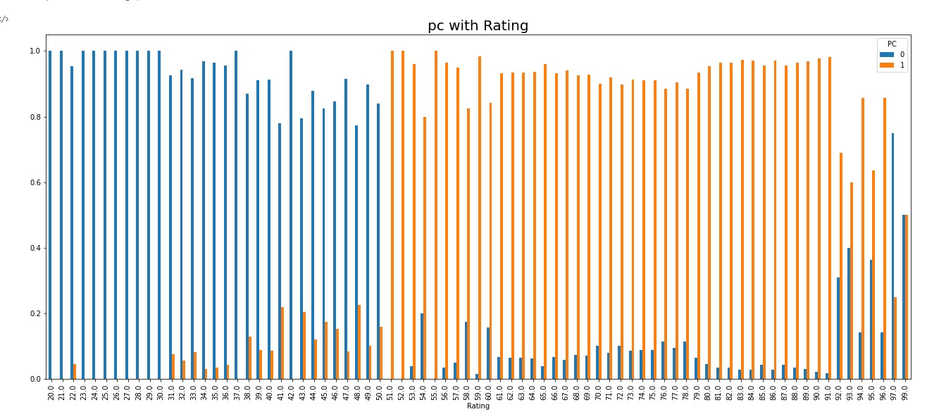
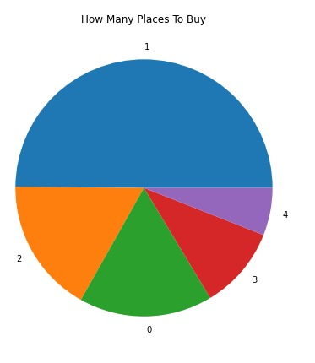
Platforms Visualization
After combining PlayStation 5 platform with the rating, we can see from the graph that there’s not a connection between if the game available on this platform and it’s rating.
On the other hand, this graph show’s the connection between rating and pc. we can see a strong connection between the Game’s rating and that the game is available to play on PC.

Slide 9
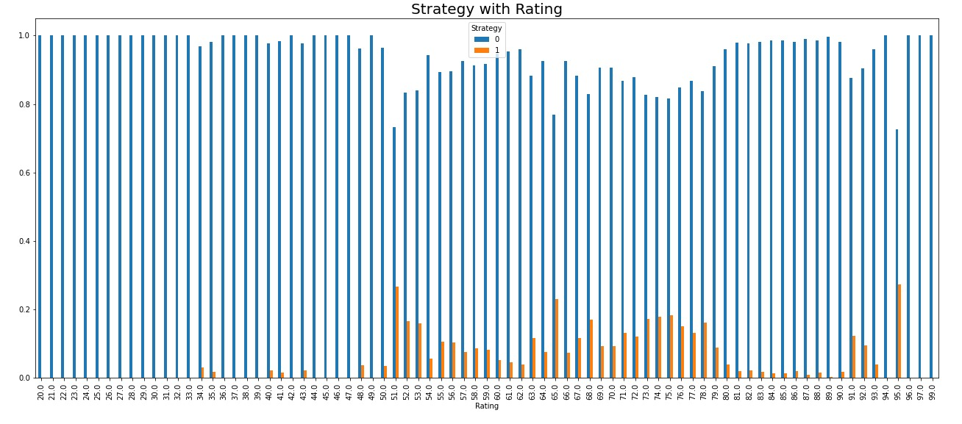
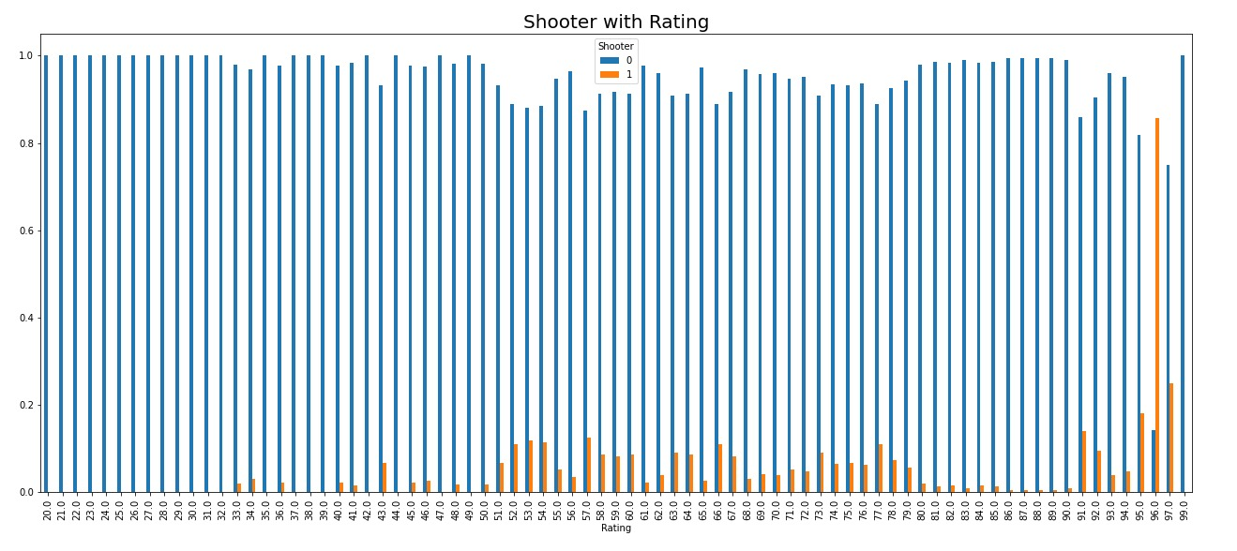
Genres Visualization
From this graph we can see that if the genre of the game is strategy we can assume it’s rating will be between 50 to 80.
On the other graph we can see that most of the shooters game’s rating are low, but there’s some shooter games that are successful

Slide 10
Machine Learning
Linear Regression and Auto-Sklearn 2.0

Slide 11

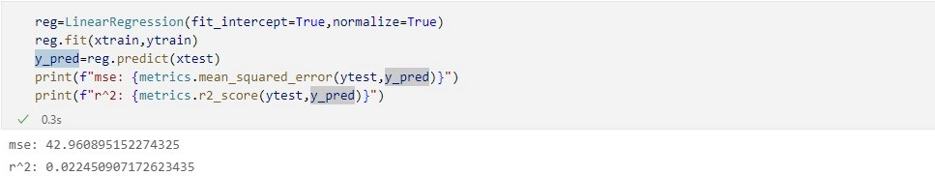
Firstly we used linear regression to
Help us predict, but we encountered several problems.
and the score results were low (0.02).
We used one hot method to improve our data.
And finally changed our machine learning to be
auto-sklearn to get much better result

Slide 12
ONE HOT: Games Platforms
We Changed Game Platforms column to be one hot.
We choose the best 6 platforms that had the most games available on them,
and insert them as columns in our data frame.
each column have one or zero value, that represent if the game is available on this platform or not.
Nintndo Switch
PlayStation 5
Xbox One
PlayStation 4
Xbox Series
PC

Slide 13
ONE HOT: Game Genres
We Changed Genres column to be one hot.
We choose the 6 most popular genres.
each column have one or zero value, that represent if the game is available on this platform or not.
Indie
Adventure
Action
Shooter
RPG
Strategy

Slide 14

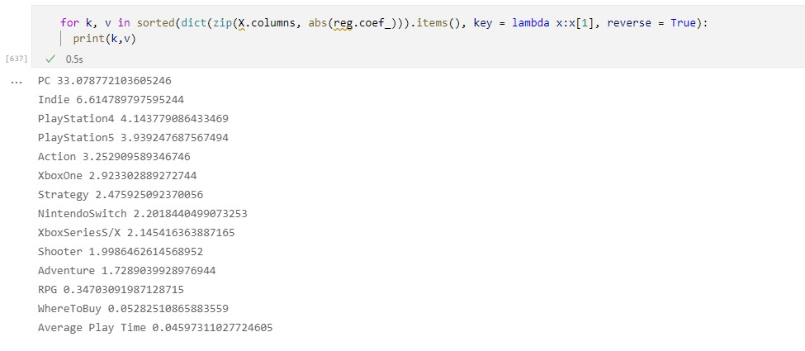
Linear Regression: Coefficion Result
After changing to one hot, we ran the linear Regression ML again, we got result of 0.5.
The coefficion reuslt gave us the most feautre importance. we can See that the PC feture as the most impact on the rating.
Aswell we can notice that Average Play Time did not impact the result nearly at all.

Slide 15

The linear regression result weren’t good enough,
So we tried to improve!

Slide 16
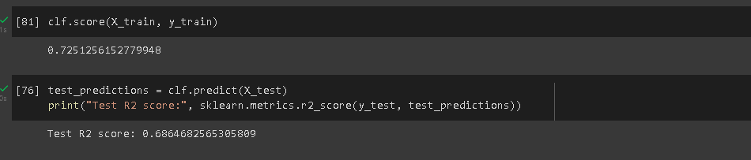
Auto-sklearn 2.0
Stage 1
Stage 2
Stage 3
We used auto-sklearn to predict our model.
The data was divided into two groups.
one is learning group(80%) and another is testing(20%).
Finally we tested our model
And got our results.
Which were improved by a lot! .

Slide 17
Conclusion
In conclusion, the research Question that we asked, now can be answered.
As we showed, the number one effect on rating is that on which platform you can play the game.
In our result it’s clear to see that PC has the most effect on the ML, and the last effective one average play time of the game.
Also we can see that Indie genre is the second most effective feature on the ml.
To sums things up, after long and hard project, in which we encounter many problems, mainly regarding the scrawling and gathering of data, we managed to meet our goals, and delivered the best result possible.

